Slide 1
Length of Growing Period under different Climate Change Scenario
Presenter:
Satyam Kumbhar
Akriti Dhyani
Anusha Parida
Manisha Shetty
Guide:
Dr. B.I. Karande

Slide 2
Introduction
The length of the growing season in any given region represents the number of days when plant growth takes place. Knowledge on the date of onset of rains helps to plan the agricultural operations better, particularly, land preparation and sowing. The ‘length of the rainy season’ is the duration between the onset and end of agriculturally significant rains. The LGP depends not only on the rainfall distribution but also on the type of soil, soil depth, water retention, release characteristics of the soil, air temperatures and daylight hours.
Water balance can be defined as how much water is preserved in a water catchment area by considering how much water flows in and out of the watershed. Thornthwaite and Mather proposed a method that has become one of the most widely used methods to compute the balance nowadays

Slide 3
Objectives
1
To calculate Potential Evapotranspiration (PET):Estimate PET values to assess the atmospheric demand for water, which is critical for understanding crop water requirements throughout the growing season in climate change scenario.
2
Determine the Length of Growing Period (LGP):Identify key phases such as the start of the season, humid period, and end of the growing period using the relationship between precipitation (P) and PET/0.5 PET.
3
Visualize PET and LGP Trends for Weekly Analysis:
Plot precipitation, PET, and 0.5 PET curves to mark critical growing phases, ensuring effective planning and management of agricultural activities.

Slide 4
Literature Review
Thornthwaite-Mather water balance analysis in Tambakbayan watershed, Yogyakarta, Indonesia Adam Rus Nugroho1,* , Ichiro Tamagawa1 , Almaika Riandraswari2 , and Titin Febrianti2
A climatic water balance model ‘WatBal’ for bioclimatic classification and agro-climatic analysis S. Srinivas1, C.V. Srinivas3, K.M. Nair1 , L.G.K. Naidu1 , Dipak Sarkar2 and S.K. Singh2
Variability study on the length of growing period (LGP) using ground and space based (MODIS) data for the selected mandals of Warangal district, Merugu ThirupathiI*, A.V. ShashikalaII, Mathyam PrabhakarI

Slide 5
Methodology
Calculating PET using Thornwaithe Formula
Calculation of LGP
Suggesting crops suitable for the areas
Water Balance
Calculation
Visualizing PET,P,1/2PET for critical growth period analysis.

Slide 6
STUDY AREA
01
02
03
GUJARAT
Districts
NAVSARI
ANAND
KUTCH

Slide 7

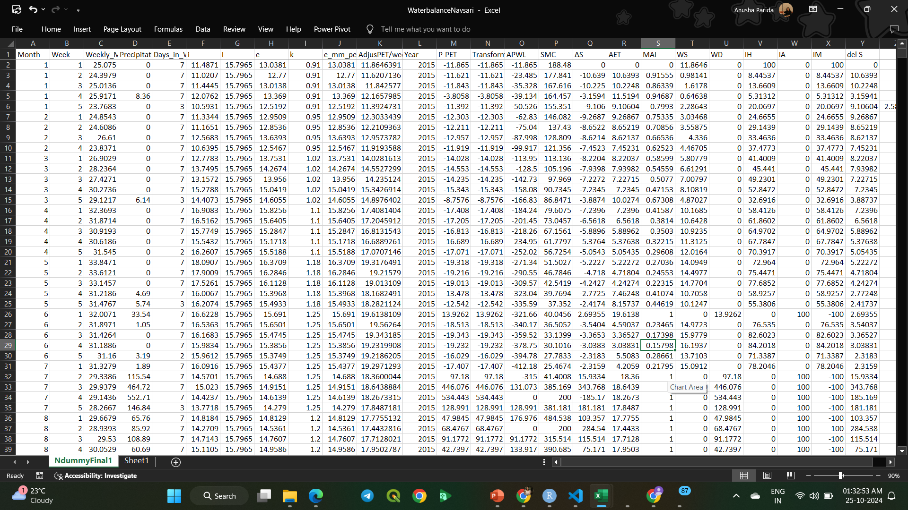
DATASET

Slide 8
Thornwaithe Formula for Potential Evapotranspiration calculation
e = 1.6 ( 10 t / I ) a
where, e = unadjusted PET ( cm / month )
t = Mean air temperature ( °C )for the concerned month
I = Annual or seasonal heat Index (i.e.), the summation of 12 values of monthly heat indices (i) when i = ( t / 5 )1.514
a = an empirical exponent computed by the equation
a = 0.000000657 I3 - 0.0000771 I2 + 0.01792 I + 0.49239
The factor e is an unadjusted value based on a 12 hour day and 30 day month. It is corrected by actual day length in hours, h, and days in a month M, to get the adjusted PET.
For daily computation, the formula is modified as under :
PET = k x e x 10 / No. of days in month
Expressed in mm / day.
where, k = adjustment factor for which table values are given by Michael (1978)

Slide 9
Why Water Balance is calculated?
Water balance is calculated to understand the availability, movement, and distribution of water in a system.
Agricultural Planning and Crop Management:
Helps determine whether crops have sufficient water during critical growth phases. Understanding the balance between precipitation and evapotranspiration (PET) ensures optimal irrigation scheduling and prevents water stress or over-irrigation.
Monitoring Soil Moisture Dynamics:
Tracks the replenishment and depletion of soil moisture, helping identify periods of water deficit (when PET > precipitation) or surplus (when precipitation > PET). This is essential for sustainable farming and drought management.
Efficient Water Resource Management:
Supports decision-making in water management by assessing how much water is available for agricultural, industrial, and domestic use. This helps optimize water usage, particularly in water-scarce regions.

Slide 10
The soil water balance equation is generally written in the form of:
P- O – U – E ±Δ W = 0
Where
W is the change in soil storage (initial minus final)
P: Precipitation and run-off
O: Deep drainage
U: is the amount of water passing beyond the root zone
E: is the evaporation (including transpiration) from the plant and soil.
In the above equation except Δ W all the elements are measured or estimated and Δ W obtained by difference.
Computation of water balance:
Input data
Rainfall
Potential evapotranspiration (PET)
Available water capacity of the soil (AWC)
Output
Soil moisture storage
Actual evapotranspiration (AET)
Water surplus (WS)
Water deficit (WD)
Moisture availability index (MAI)

Slide 11
USE OF MAI INDEX
Moisture Availability Index (MAI)
 | It is the ratio of AET to PET and is good indicator of moisture availability to crops.
 | MAI>0.75 :Excellent for crop growth
 | 0.50<MAI<0.75: Good for crops
 | 0.20<MAI<0.50 :Crops under moderate stress
 | MAI<0.25 :Crops under severe stress

Slide 12
Calculating the Length of the Growing Period (LGP)
The length of the growing period (LGP), as defined by the Agro-Ecological Zones project carried out at FAO is the period (in days) during a year when precipitation exceeds half the potential evapotranspiration, plus a period required to evapo-transpire an assumed 100 mm of water from excess precipitation stored in the soil profile. A "normal" growing period has the following characteristics:
Start of Growing Period:
Precipitation ≥ 0.5 PET
Ensures crop germination starts under reliable rain.
Humid Period:
Precipitation > PET
Sufficient water for crop growth; replenishes soil moisture.
End of Growing Period:
Precipitation < 0.5 PET
Indicates the effective end of the rainy season, with crops relying on stored soil moisture for final maturation.

Slide 13
NAVSARI

Slide 18
ANAND

Slide 23
LENGTH OF GROWING PERIOD VARIABILITY
Year | 2020 | 2030 | 2040 | 2050 | 2060 | 2070 | 2080 | 2090 | 2100
LGP (Weeks) | 15 | 12 | 9 | 12 | 16 | 8 | 11 | 18 | 8
Year | 2020 | 2030 | 2040 | 2050 | 2060 | 2070 | 2080 | 2090 | 2100
LGP (Weeks) | 11 | 12 | 6 | 14 | 12 | 5 | 9 | 12 | 11

Slide 24
ANALYSIS RESULT OF ANAND DISTRICT
MAI Values
MAI > 0.5 indicates sufficient moisture availability between 23th and 42th weeks, based on a 10-year interval analysis.
Start of Growing Period
From 24th to 33rd week (in mansoon), precipitation ≥ ½ PET, marking the onset of the growing period.
Moisture Surplus Period
Between 20th and 40th weeks, precipitation exceeds PET, providing surplus moisture for soil moisture replenishment.
Dry Periods
1st to 20th week (early in the year) and 45th to 52nd week (end of the year) show precipitation < ½ PET, signaling the Crop under Moderate and Severe Stress and reliance on Irrigation.

Slide 25
Recommended Crops for Navsari Based on MAI Analysis(Kharif Season)
Rice (Paddy):
Why: The precipitation during the 20th to 40th weeks exceeds PET, ensuring enough water for rice, which is a water-intensive crop.
Sowing Time: Early Kharif season (June-July).
Benefit: Surplus water replenishes soil moisture, improving crop health.
Pulses (Moong, Urad):
Why: Short-duration pulses can utilize the early growing season (10th-20th week) when precipitation meets half PET.
Sowing Time: June-July (with early rains).
Benefit: Pulses fix nitrogen in the soil, improving soil fertility.
Vegetables (Okra, Cucurbits):
Why: Vegetables can be grown during this period to take advantage of the moisture surplus.
Sowing Time: Mid-July to August.
Benefit: High moisture availability reduces irrigation needs.

Slide 26
ANALYSIS RESULT OF NAVSARI DISTRICT
MAI Values
MAI > 0.75 indicates sufficient moisture availability between 30th and 40th weeks, based on a 10-year interval analysis.
Start of Growing Period
From 10th to 20th week, precipitation ≥ ½ PET, marking the onset of the growing period.
Moisture Surplus Period
Between 20th and 40th weeks, precipitation exceeds PET, providing surplus moisture for soil moisture replenishment.
Dry Periods
1st to 20th week (early in the year) and 40th to 52nd week (end of the year) show precipitation < ½ PET, signaling the end of the rainy season and reliance on stored soil moisture.

Slide 27
Recommended Crops for Anand Based on MAI Analysis
(Kharif Season)
Groundnut:
Why: Requires moderate rainfall during weeks 10 to 30, coinciding with its growth phase.Sowing Sowing Time: June-July (Kharif season)..
Benefit: Adequate moisture supports pod development and improves yield.
Pulses (Moong, Urad, Tur):
Why: Short-duration pulses can utilize the early growing season (10th-20th week) when precipitation meets half PET.
Sowing Time: June-July (with early rains).
Benefit: Pulses fix nitrogen in the soil, improving soil fertility.
Vegetables (Okra, Cucurbits):
Why: Vegetables can be grown during this period to take advantage of the moisture surplus.
Sowing Time: Mid-July to August.
Benefit: High moisture availability reduces irrigation needs.

Slide 28
THANK YOU

